Slide 1

Introduction of the 2022-2026 Virginia Rural Health Plan
and Data Commons
Presenting on behalf of the
Virginia State Office of Rural Health
Sarah O’Connor, MPH
Clarissa Noble, MPH
Presenting on behalf of the UVA Biocomplexity Institute
Aaron Schroeder, PhD
Sallie Ann Keller, PhD
This publication was supported by the Health Resources and Services Administration (HRSA) of the U.S. Department of Health and Human Services (HHS) as part of a financial assistance award totaling $125,236.09, with 100 percent funded by HRSA/HHS. The contents are those of the author(s) and do not necessarily represent the official views of, nor an endorsement, by HRSA/HHS, or the U.S. Government.

Slide 2


Housekeeping
Presentation is being recorded via Zoom
Slide deck available upon request
Q&A will take place after the presentation

Slide 3


Audience Takeaways
Understand the approach to and development of the 2022-2026 Virginia Rural Health Plan (VRHP)
Introduce the Virtual Rural Resource Toolkit to support the VRHP that was created in partnership with the Rural Virginia Initiative, Healthcare and Community Well-being Working Group
Debut the county-level interactive data commons to support the VRHP, in partnership with the UVA Biocomplexity Institute, Social and Decision Analytics Division
Topic Spotlight: Education
Kiptopeke State Park
: Rachel Stevens

Slide 4


Virginia State Office of Rural Health
(VA-SORH)
Mission:
To address and rectify health disparities affecting the rural residents of the Commonwealth of Virginia
The VA-SORH is dedicated to:
Fostering collaboration and leveraging resources across and within various levels of government, communities, and non-profit organizations
Collecting and disseminating information to stakeholders
Providing technical assistance
Assisting the coordination of rural health interests statewide
Recruitment and retention of health professionals in rural and medically underserved areas
Notes:
The Virginia State Office of Rural Health (VA-SORH) was established in 1991 to create, fund and support quality and sustainable rural healthcare infrastructure. VA-SORH is a designated, federally funded office by the Health Resources and Services Administration (HRSA) Federal Office of Rural Health Policy (FORHP).
The purpose and mission of VA-SORH is to address and rectify health disparities affecting the rural residents of the Commonwealth of Virginia.
For nearly 30 years, VA-SORH has provided funding that connects small rural communities with state and federal resources with the goal of developing long-term solutions to address the root causes of rural health disparities.
VA-SORH is dedicated to:
Fostering collaboration and leveraging resources across and within various levels of government, communities, and non-profit organizations
Collecting and disseminating information to stakeholders
Providing technical assistance
Assisting the coordination of rural health interests statewide through assessment and planning efforts
Supporting efforts to improve recruitment and retention of health professionals in rural and medically underserved areas

Slide 5


Virginia State Office of Rural Health
VA-SORH Innovative Rural Programming Awards
Healthy Moms & Babies
Food Access & Nutrition
Workforce Development
Behavioral Health
Telehealth
Rural Healthcare Workforce Incentive Programs
State Loan Repayment Program (SLRP)
Tobacco Region Revitalization Commission
Behavioral Health Loan Repayment Program (BHLRP)
Conrad 30 Waiver Program (J-1)
Nursing Preceptor Incentive Program (NPIP)
VA-SORH Partnerships & Collaborations
Virginia Rural COVID-19 Response & Relief Program
(COVID-19 Rural Health Disparities Grant)
Conference Sponsorships
Virginia Association of Free & Charitable Clinics
United Way of Southwest Virginia
Development of the Statewide Telehealth Pan
Office of EMS Rescue Squad and Relief Fund
Rural Hospital Programs
Small Rural Hospital Improvement Grant Program (SHIP)
SHIP COVID-19 Testing & Mitigation
Medicare Rural Hospital Flexibility Program (FLEX)
Notes:
Virginia State Office of Rural Health accomplishes its mission through several rural health programs:
VA-SORH Innovative Rural Programming Awards
Healthy Moms & Babies
Food Access & Nutrition
Workforce Development
Behavioral Health
Telehealth
Rural Healthcare Workforce Incentive Programs
State Loan Repayment Program (SLRP)
Tobacco Region Revitalization Commission
Behavioral Health Loan Repayment Program (BHLRP)
Conrad 30 Waiver Program (J-1)
Nursing Preceptor Incentive Program (NPIP)
VA-SORH Partnerships & Collaborations
Virginia Rural COVID-19 Response & Relief Program
(COVID-19 Rural Health Disparities Grant)
Conference Sponsorships
Virginia Association of Free & Charitable Clinics
United Way of Southwest Virginia
Development of the Statewide Telehealth Pan
Office of EMS Rescue Squad and Relief Fund
Rural Hospital Programs
Small Rural Hospital Improvement Grant Program (SHIP)
SHIP COVID-19 Testing & Mitigation
Medicare Rural Hospital Flexibility Program (FLEX)

Slide 6
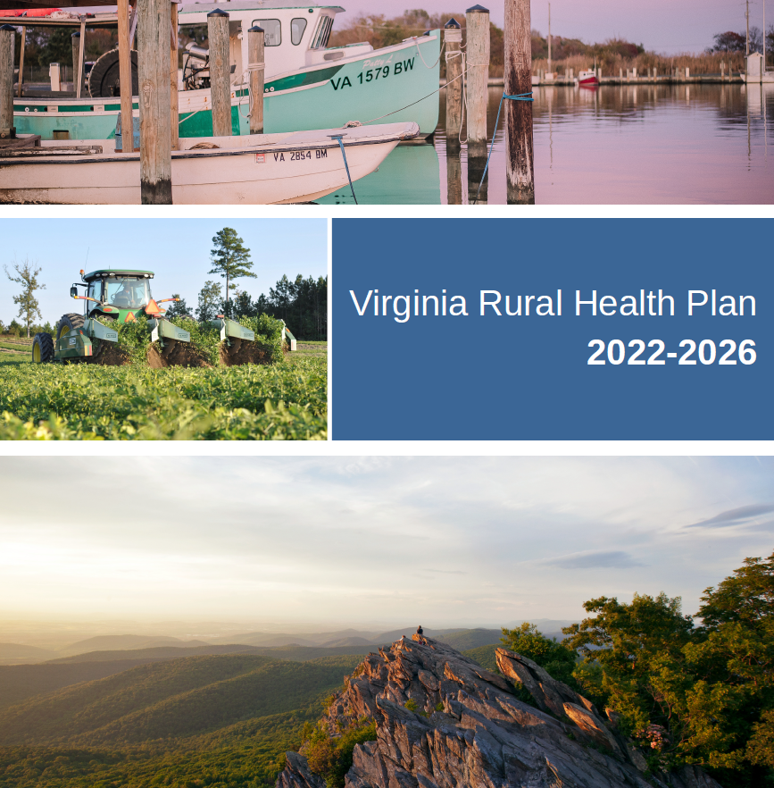
Virginia Rural Health Plan 2022-2026
Question: What is most important to a rural community?
Goals:
Community-informed lens
Asset-based approach
Define rurality
Identify priority VA-SORH metrics

Slide 7
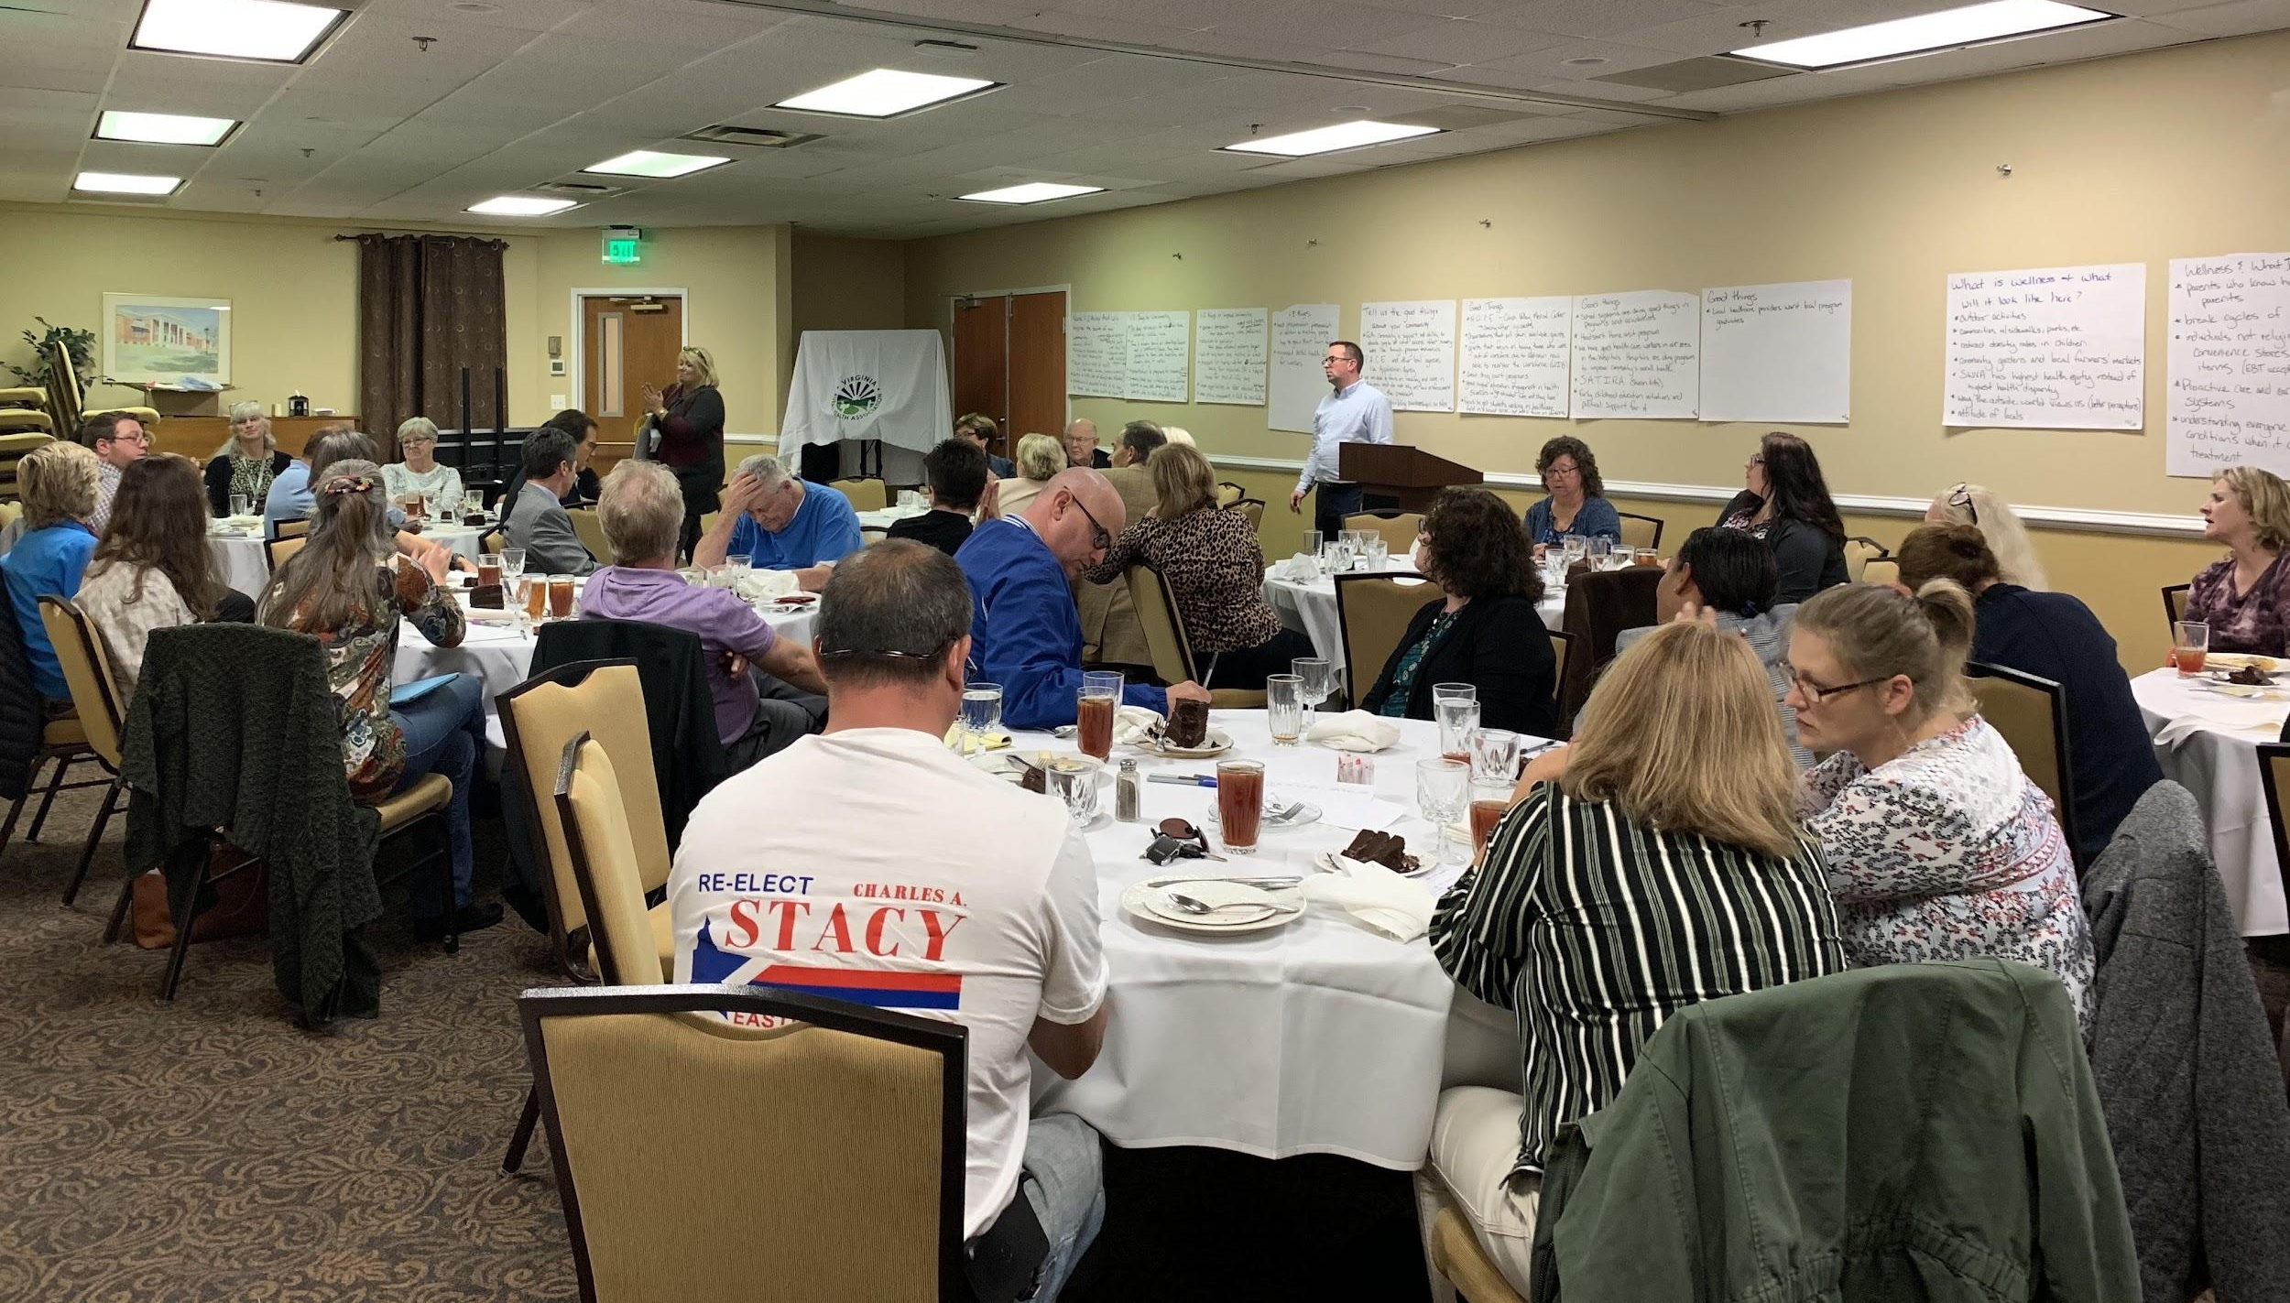

Virginia Rural Health Plan 2022-2026
Community Conversation, Bluefield, VA
Approach
Meet people where they are through community-driven conversations
Conversations to be held in locality familiar, centralized to attendees
Local Community facilitator to lead the conversation
Absolutely NO powerpoint presentation
Converse over a warm meal, catered by a local restaurant
Conduct site visits and met with local leaders, agencies, grassroots organizations
COVID-19 Response
REDCap online survey version of the Community Conversation questions to share with the remaining communities and other key stakeholders
Conducted phone interviews with community leaders and organizations

Slide 8

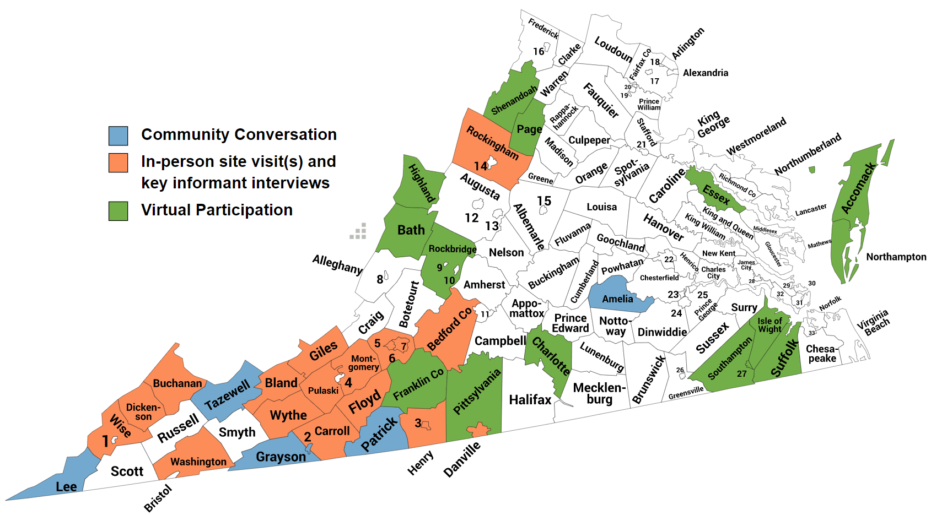


Outreach-Community Informed Lens
Where to go?
RWJF’s Community Health Rankings
ARC’s Economic Distress Index
OHE’s Health Opportunity Index
Lived Experience
Developing Plan Framework:
Qualitative data analysis identified recurring topics
Themes created the framework of the VRHP
Identified community/regional leading and promising practices
Notes:
Virginia’s rural counties/communities are geographically spread out throughout the Commonwealth. We wanted to visit communities that were a little harder to reach geographically and whose voices may not have been heard in quite some time, but also used a data-informed lens to locate these communities.
We utilized the Robert Wood Johnson Foundation’s Virginia Community Health Rankings, Appalachian Regional Commission’s Economic Distress index for Virginia's Appalachian/highlands region.
We utilized our Health Opportunity Index and compared community profiles at the census tract level.
Finally, we took into account the lived experience of our workgroup.
The map illustrates our mixed-method approach to data collection, our outreach footprint and our pivoting to virtual means due to COVID-19.
The qualitative data we collected included commentary taken directly from attendees at the community conversations, “world cafe style” written responses on large poster boards, open-ended electronic survey responses, in-person and virtual key informant and subject matter expert interviews
Qualitative data analysis identified recurring topics that were discussed
Recurring topics yielded themes which laid the foundation of the VRHP
Identified community/regional leading practices to rural health challenges to spotlight within the plan
The qualitative data that we collected during our travels helped us validate the quantitative data, and also learn of upstream root causes to rural inequities that hasn't been quantified yet * need an example or omit
(Not for speaking, just for reference) Qualitative Data Analysis Methodology:
Transcribed all responses
Software Utilized - NVivo
Generate cluster analysis diagram to group responses that share similar words, attribute values or coding.
Generated a hierarchical chart to visualize patterns of distribution of thematic codes
Working group discussed results in conjunction with quantitative data
Recommended 13 topics to create framework for the plan

Slide 9



Virginia Rural Health Plan 2022-2026
Recurring Topics
Education as the Backbone in Rural Virginia
Healthy Housing
Broadband Internet Supporting Rural Virginia
Transportation
Nutrition and Food Security
Healthy Moms and Babies
Access to Health Care Services
Behavioral Health, Substance Use Disorder and Recovery
Healthy Minds and Bodies
Built and Natural Environment
Aging in Place and Addressing Social Isolation
Elevating Rural Workforce Development and Employment
Financial Proficiency: Leveraging Individualized Resources
Notes:
Recurring Topics
Education as the Backbone in Rural Virginia
Broadband Internet Supporting Rural Virginia
Healthy Housing
Transportation
Nutrition and Food Security
Healthy Moms and Babies
Access to Health Care Services
Behavioral Health, Substance Use Disorder and Recovery
Healthy Minds and Bodies
Built and Natural Environment
Aging in Place and Addressing Social Isolation
Elevating Rural Workforce Development and Employment
Financial Proficiency: Leveraging Individualized Resources

Slide 10
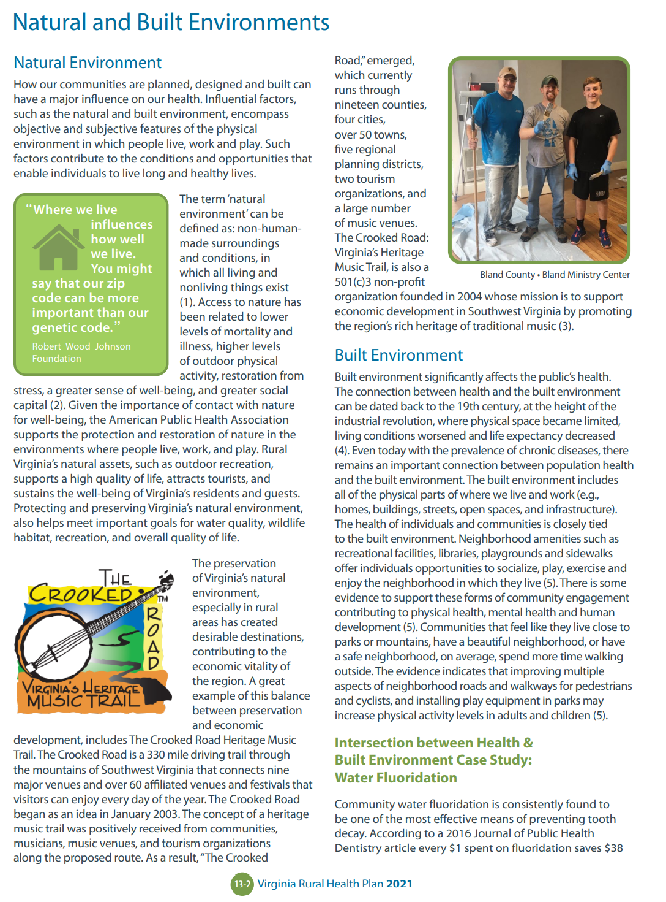
Virginia Rural Health Plan 2022-2026
Plan Development
Overview
Leading Practices and Approaches
Focus: Virginia
National programs/organizations
Opportunities for Growth
Policy recommendations
Pilot program(s)
Funding
Notes:
Overview
Leading Practices and Approaches
Focus on rural Virginia programs, organizations
Leading national programs, organizations
Need Addressed
Approach
Outcome
Opportunities for Growth
Funding suggestion
Policy Recommendation
Program activity

Slide 11
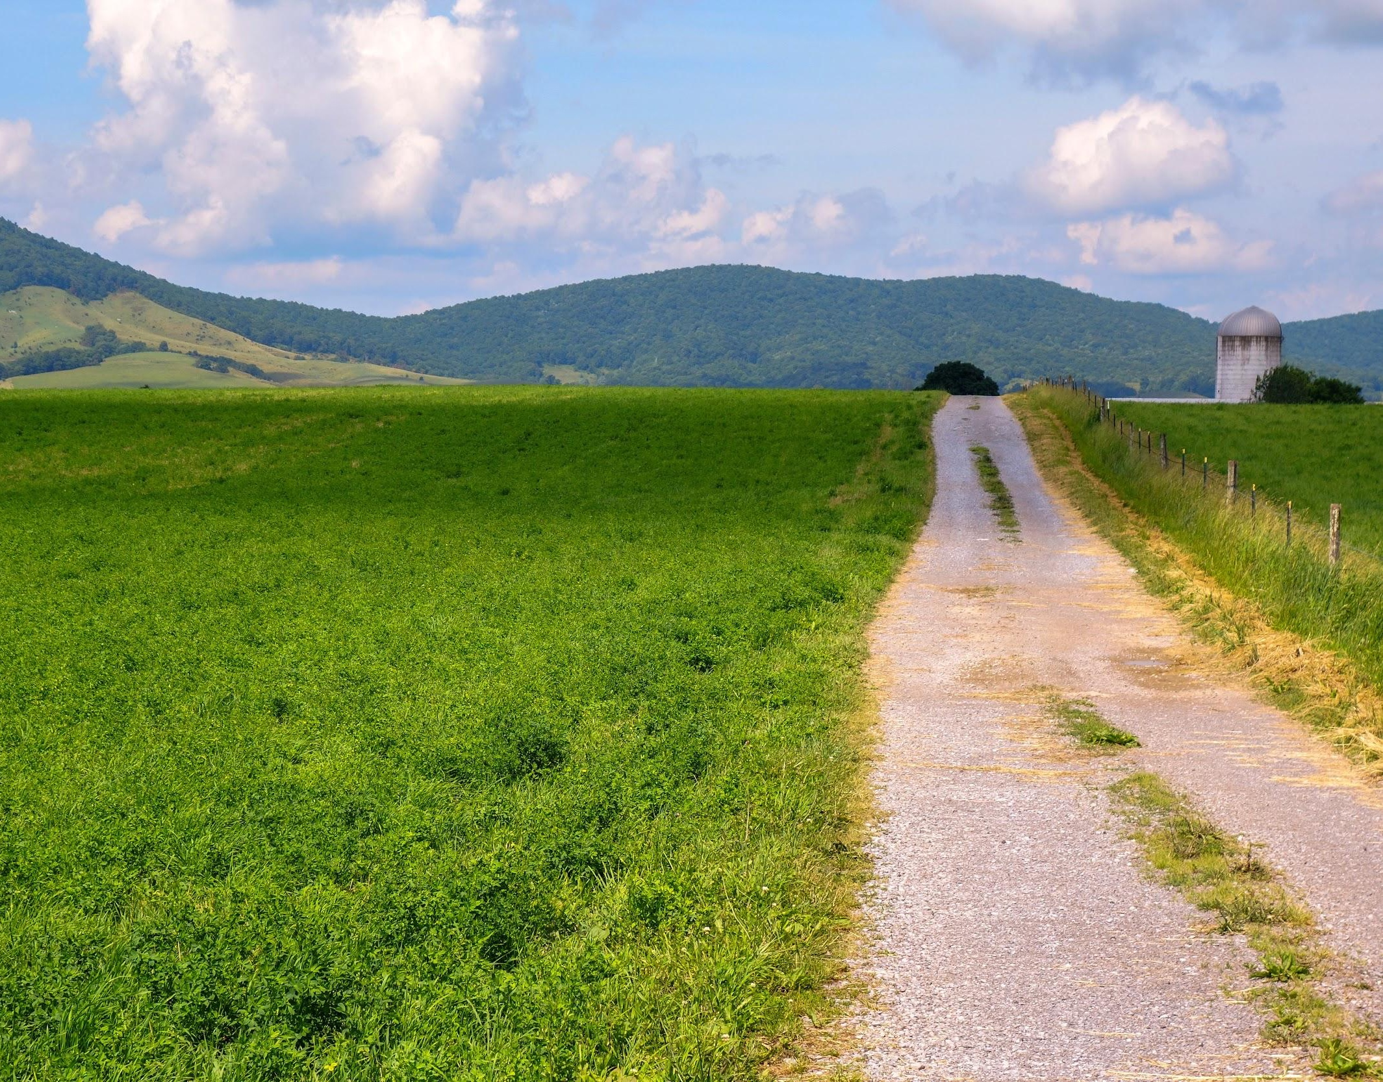

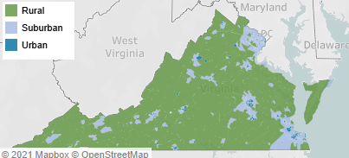
Defining Rurality
Urbanization Perceptions Small Area Index
Rural Virginia is diverse in geography, demographics, and cultural identity
Definitions vary based on the lens (economic, statistical classifications, funding opportunities)
Rurality exists within the shadows of urban cores and suburban areas
Tazewell County
Accomack County
Notes:
In the plan we showcase the various types of rural classifications and definitions.
Urbanization Perceptions Small Area Index
Rural-Urban continuum codes
Definitions historically have been tied to funding streams
Rural Virginia is diverse in geography, demographics, and cultural identity
Definitions vary based on the lens (economic, statistical classifications, funding opportunities)
Rurality exists within the shadows of urban cores and suburban areas
Vary from hundreds of miles to less than a few miles
The most common reason for the difference includes accessibility to the amenities of a metro area, such as airports, shopping centers, and cultural opportunities.
American Housing Survey (2017) asked respondents whether they thought they lived in urban, suburban, or rural areas.
When examined through this lens, it turns out that most of Virginia is rural. Indeed, of the people surveyed people living in communities covering 88% of the state consider those communities rural. Despite occupying such a large area, however, only 26% of Virginians live in these communities. By contrast, nearly three quarters of Virginians live in neighborhoods that residents believe are urban or suburban, covering just 12% of Virginia’s land.

Slide 12

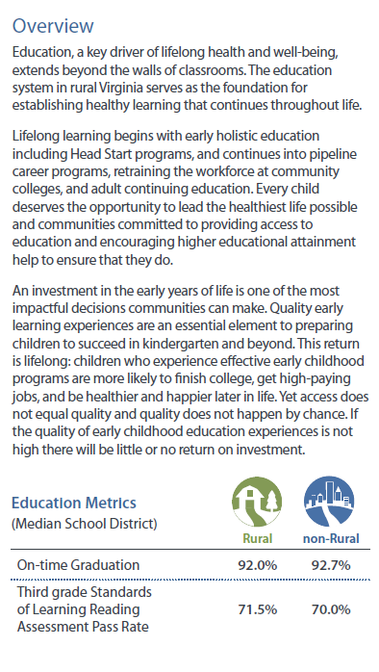
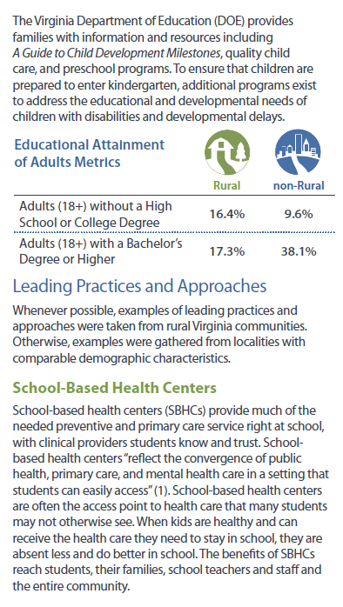
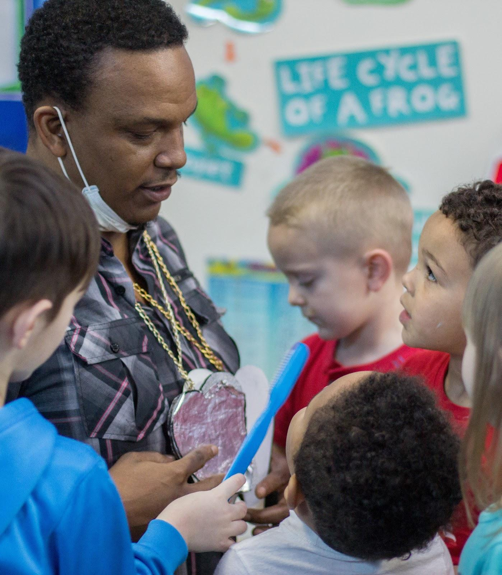
Topic Spotlight
Education: A Backbone in Rural Virginia
Southern Virginia Botanical Garden & Environmental Education Center
: VA-SORH Staff

Slide 13
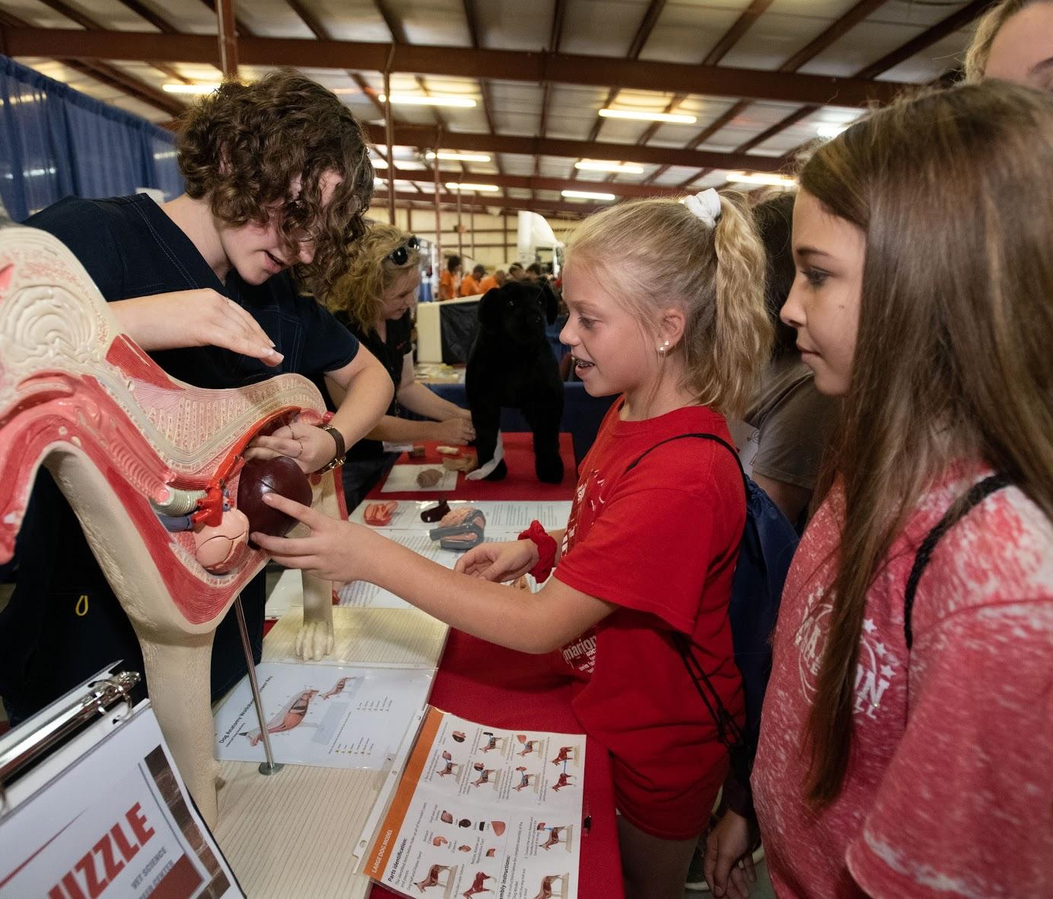
Topic Spotlight
Education: A Backbone in Rural Virginia
Opportunities for Growth
Promote literacy during early childhood by regularly providing books (recreational and educational) to children.
Ensure access to broadband and invest in current technology to provide equitable access to education.
Invest in pipeline educational programs that begin during middle school and provide students with hands-on exposure to a variety of trades and careers.
Ensure and expand opportunities to combine college preparatory academics with technical training and workplace experience.
Ensure that supporting students with learning differences is a priority. Provide regular, up-to-date information and resources to teachers on how best to support their students with learning differences and instruction on how to implement personalized education plans.
Promote new and expand current after school programs and clubs like scouting, 4-H and Trail Life for students to gain exposure to a variety of experiences and learning opportunities.
Leading Practices & Approaches
School-Based Health Centers
Highland Medical Center
Ballad Health & Lee County’s School-Based Telehealth Program
Career and Technical Education
VDOE’s Project Lead the Way
UWSWVA’s School to Career Pipeline Ignite Program
Head Start
Virginia Preschool Initiative
4-H
Notes:
Opportunities for Growth
Promote literacy during early childhood by regularly providing books (recreational and educational) to children.
Ensure access to broadband and invest in current technology to provide equitable access to education.
Invest in pipeline educational programs that begin during middle school and provide students with hands-on exposure to a variety of trades and careers.
Ensure and expand opportunities to combine college preparatory academics with technical training and workplace experience.
Ensure that supporting students with learning differences is a priority. Provide regular, up-to-date information and resources to teachers on how best to support their students with learning differences and instruction on how to implement personalized education plans.
Promote new and expand current after school programs and clubs like scouting, 4-H and Trail Life for students to gain exposure to a variety of experiences and learning opportunities.

Slide 14
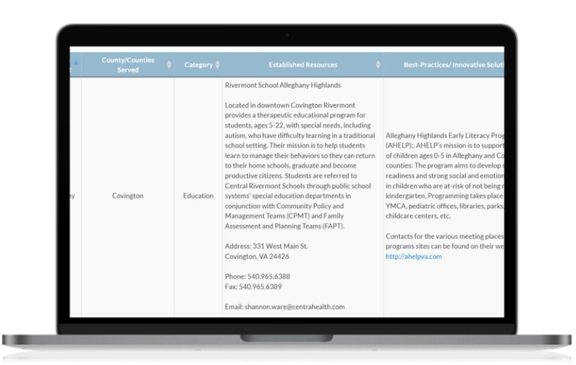
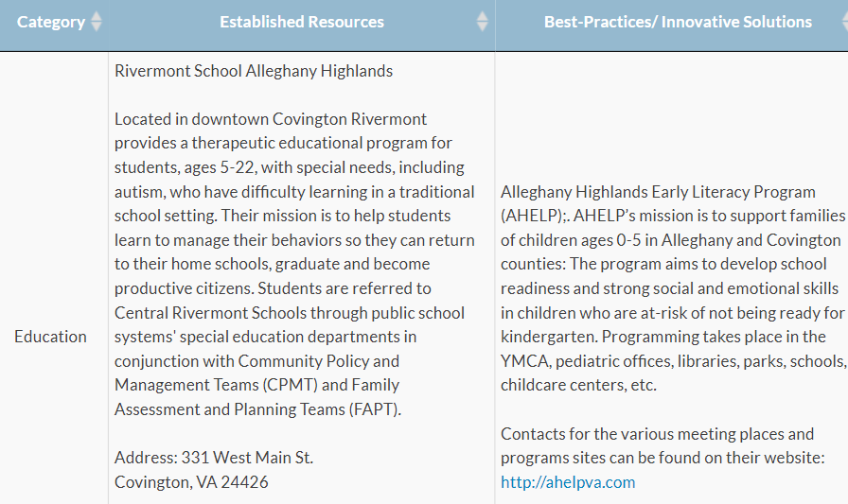

Virginia Rural Health Plan Resource Online Toolkit
Virtual
Housed on VA-SORH website
Option to search by Statewide, Health District, County/Counties
Category
Established Resources
Best Practices, Innovative Solutions
How-to Guide, Instrument
Updated continuously
Submission of additional resources
Anyone can submit information about new/available resources
Notes:
The Rural Virginia Initiative (RVI) originated as a result of legislation passed in the Spring of 2018 that tasked the University of Virginia with leading a conversation on the challenges faced by residents of rural Virginia and to prepare a white paper that recommended possible solutions. Following these initial recommendations, the University of Virginia, Virginia Tech, UVA-Wise, and Virginia State University convened a broad group of stakeholders from academia, government and the private sector to continue the dialogue. The Healthcare and Community Well-being Working Group sought to address health disparities in rural Virginia. The group collaborated with the Virginia State Office of Rural Health to develop a toolkit of community and academic resources to be deployed as part of the State Rural Health Plan Update. The toolkit contains resources that are respective to each of the topic areas presented in the plan (e.g., food security, housing) and the toolkit is accessible online at the VA-SORH website.

Slide 15
Priority Metrics
1. Education
Child Readiness via Third Grade Standards of Learning Reading Assessment
2. Broadband
Percentage of Households with Broadband
3. Nutrition and Food Security
Rates of Food Security
Rates of Food Insecurity among Households with Children
4. Healthy Moms and Babies
Adequacy of Prenatal Care Utilization via Kotelchuck Index
5. Access to Health Care Services
Rates of Avoidable Hospitalizations per 100,000 Residents
6. Behavioral Health, Substance Use Disorder and Recovery
Rates of Emergency Department Visits for Overdose (All drugs)
7. Employment/Workforce Development
Earnings/Income per Job
Employment Rates per Census Tract
Notes:
The VA-SORH has chosen seven priority areas and respective metrics to study and monitor longitudinally. In partnership with the University of Virginia Biocomplexity Institute, trends of these metrics will be visualized in a public-facing, interactive dashboard which will be accessible to our partners, stakeholders, policy-makers and the public on the VA-SORH website. These metrics aim to provide a comprehensive evaluation of the overall health and well-being of Virginia’s rural communities.
The State Office of Rural Health team is committed to continuing its work showcasing Virginia’s rural communities, providing technical assistance and resources. A portion of this work will be to measure the impact of this plan and to benefit from continuous community feedback.

Slide 16


Slide 17


Slide 18


Slide 19
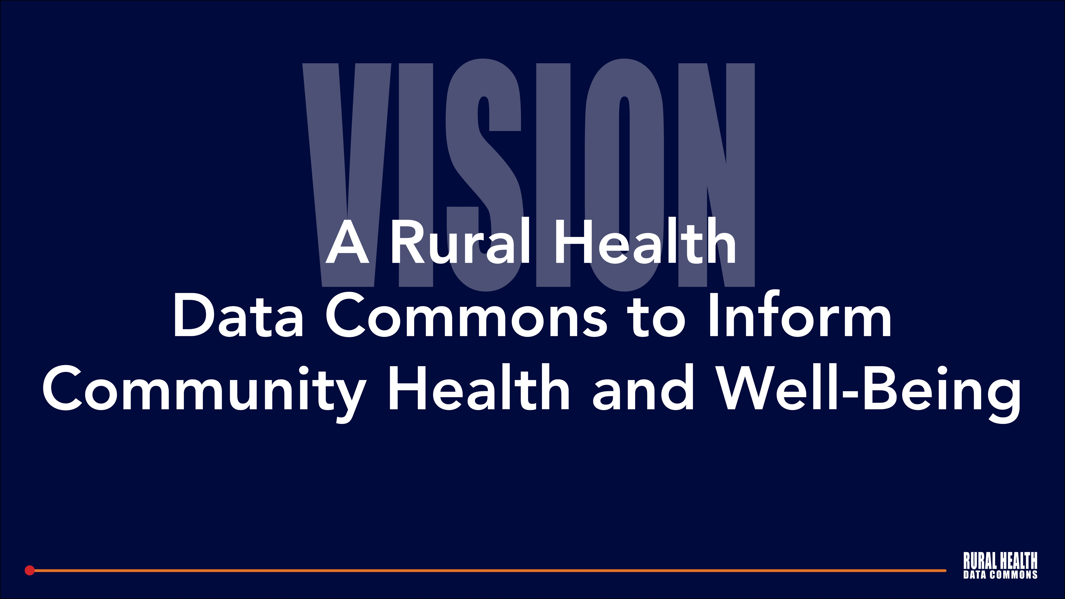

Slide 20


Slide 21
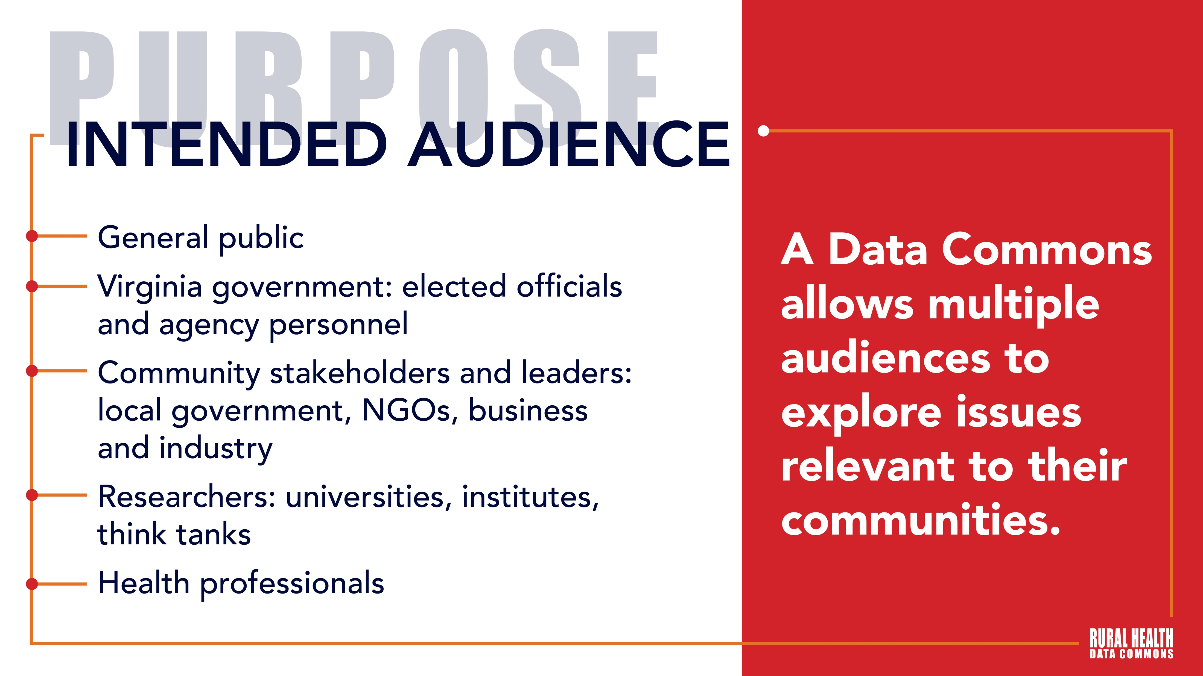

Slide 22
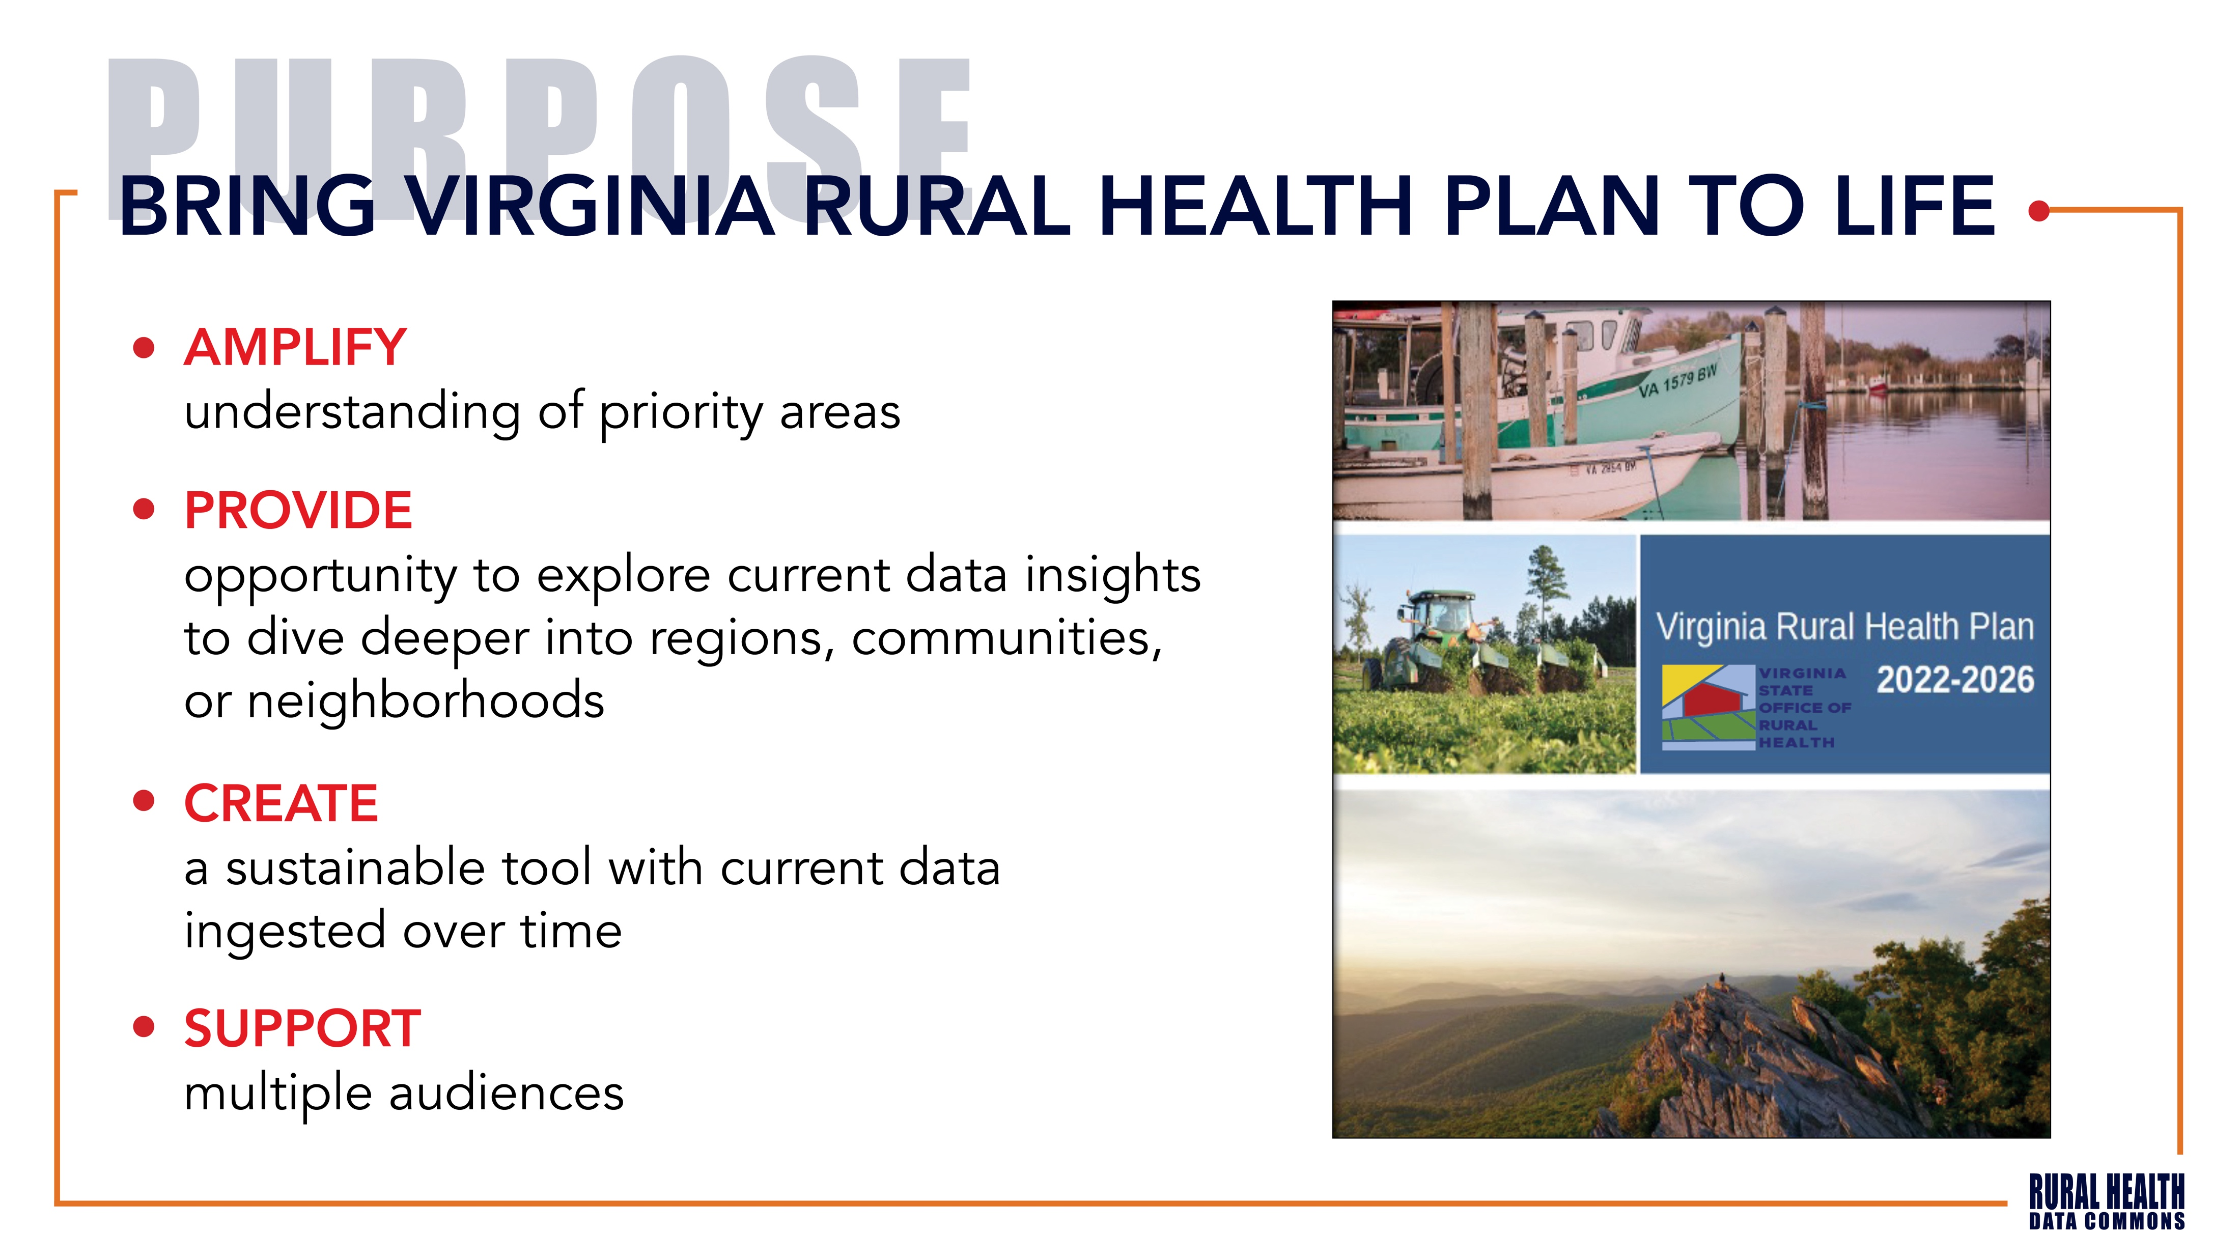

Slide 23


Slide 24
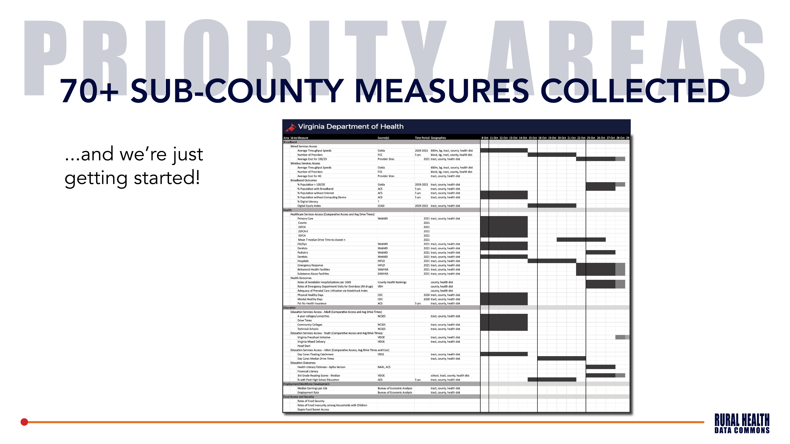

Slide 25
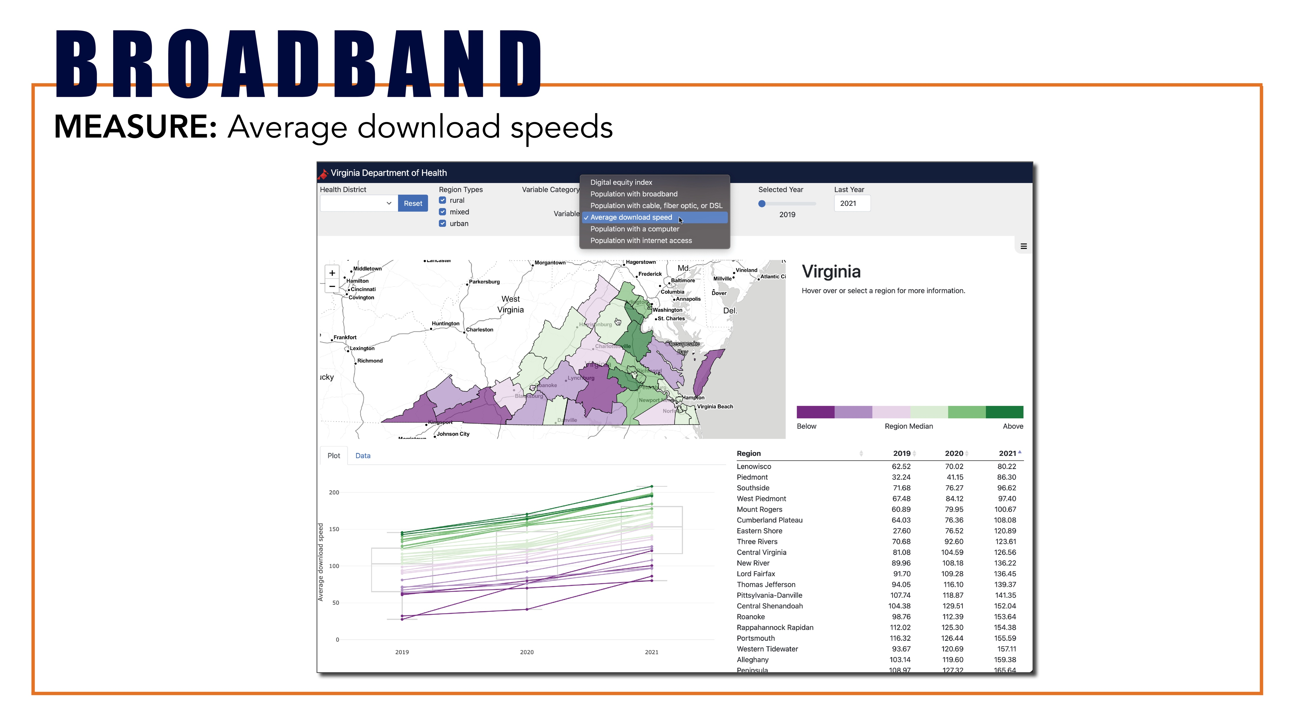

Slide 26
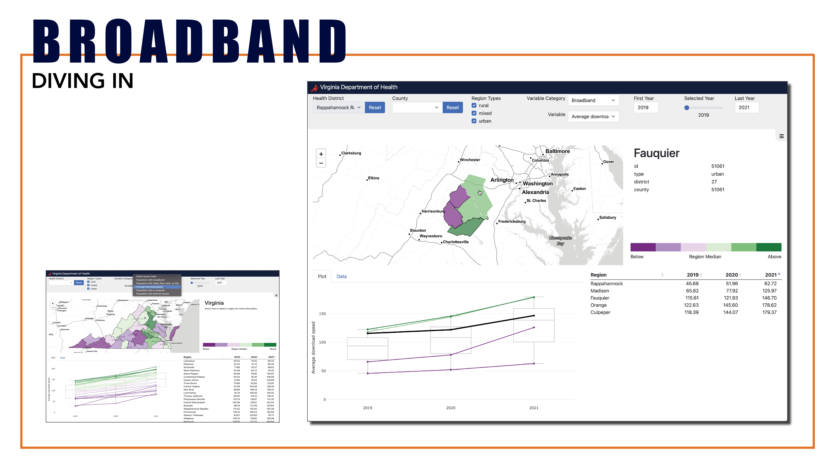

Slide 27
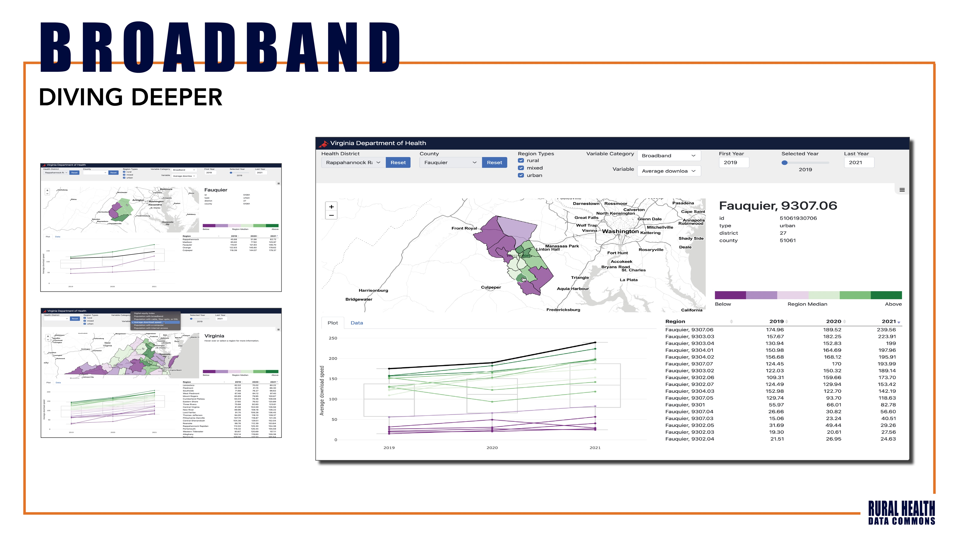

Slide 28


Slide 29
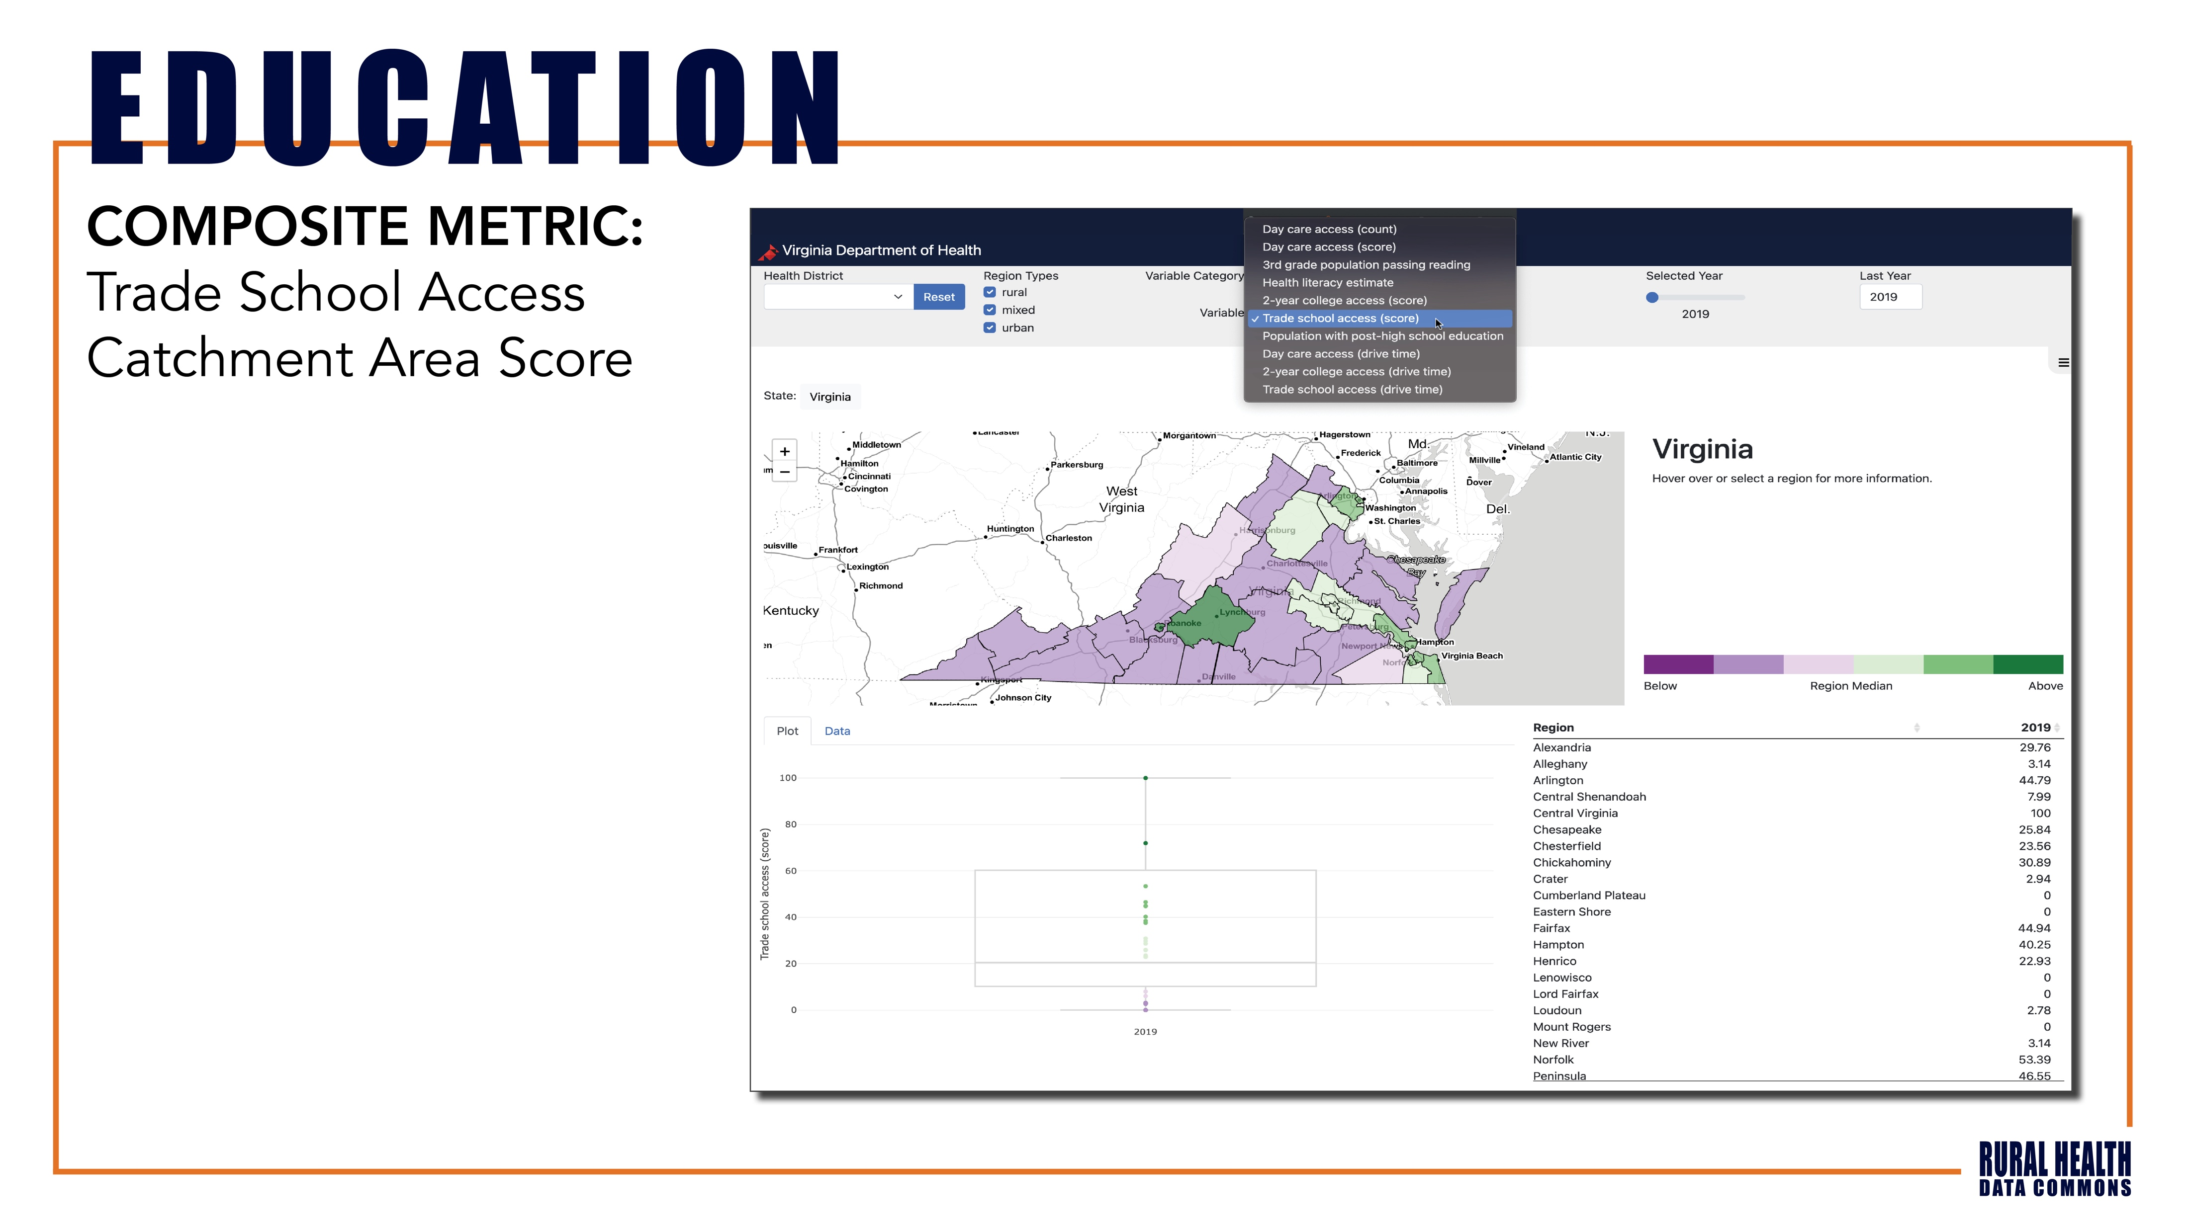

Slide 30
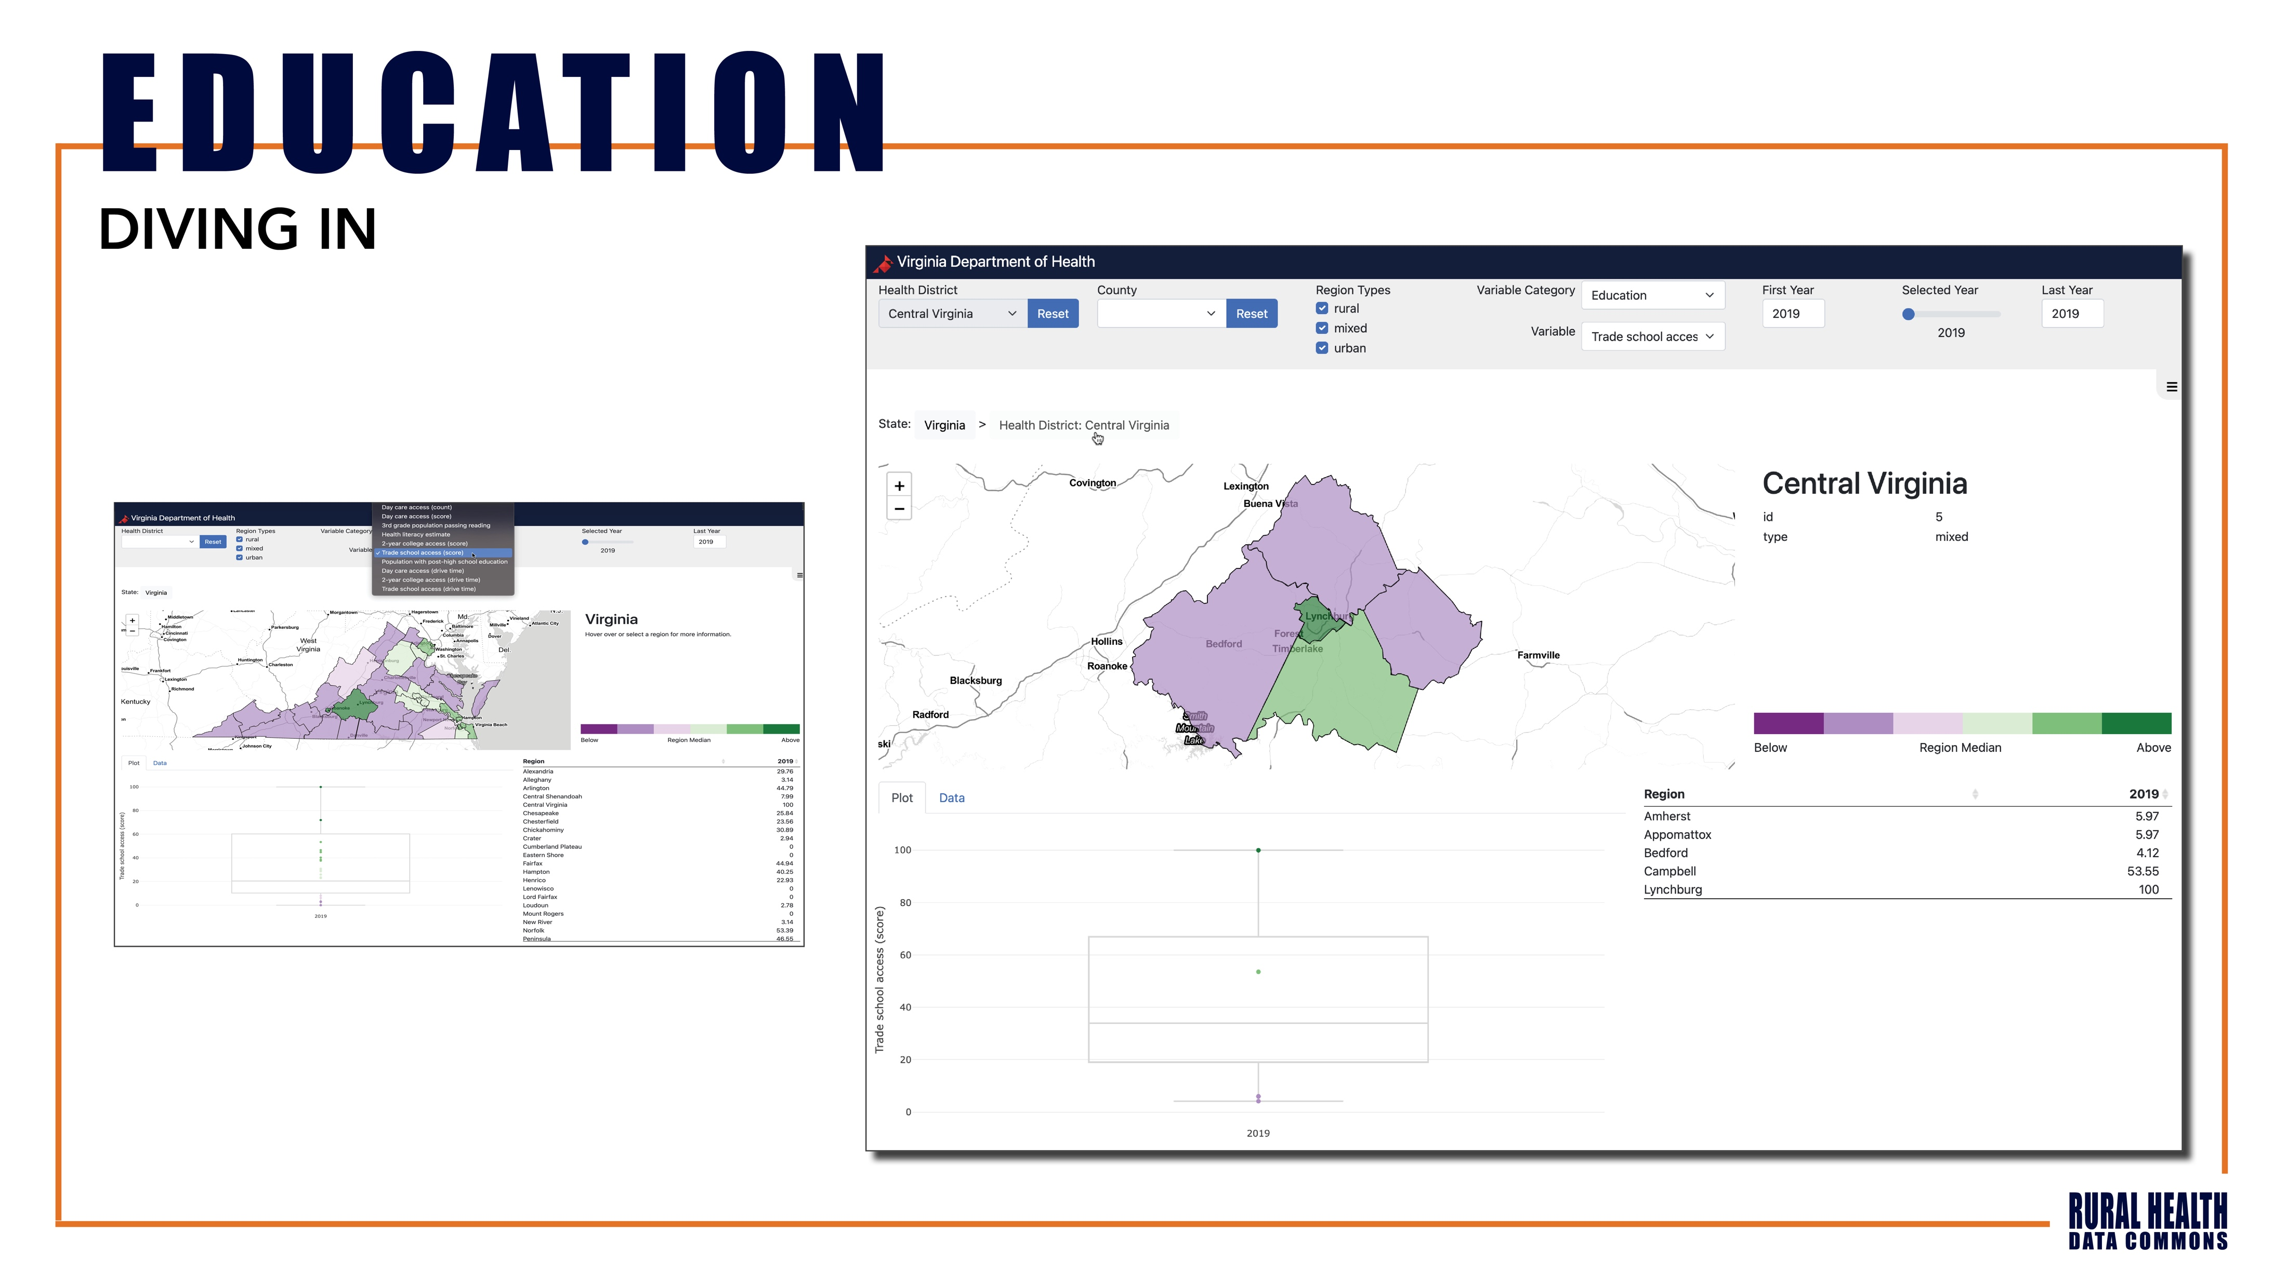

Slide 31
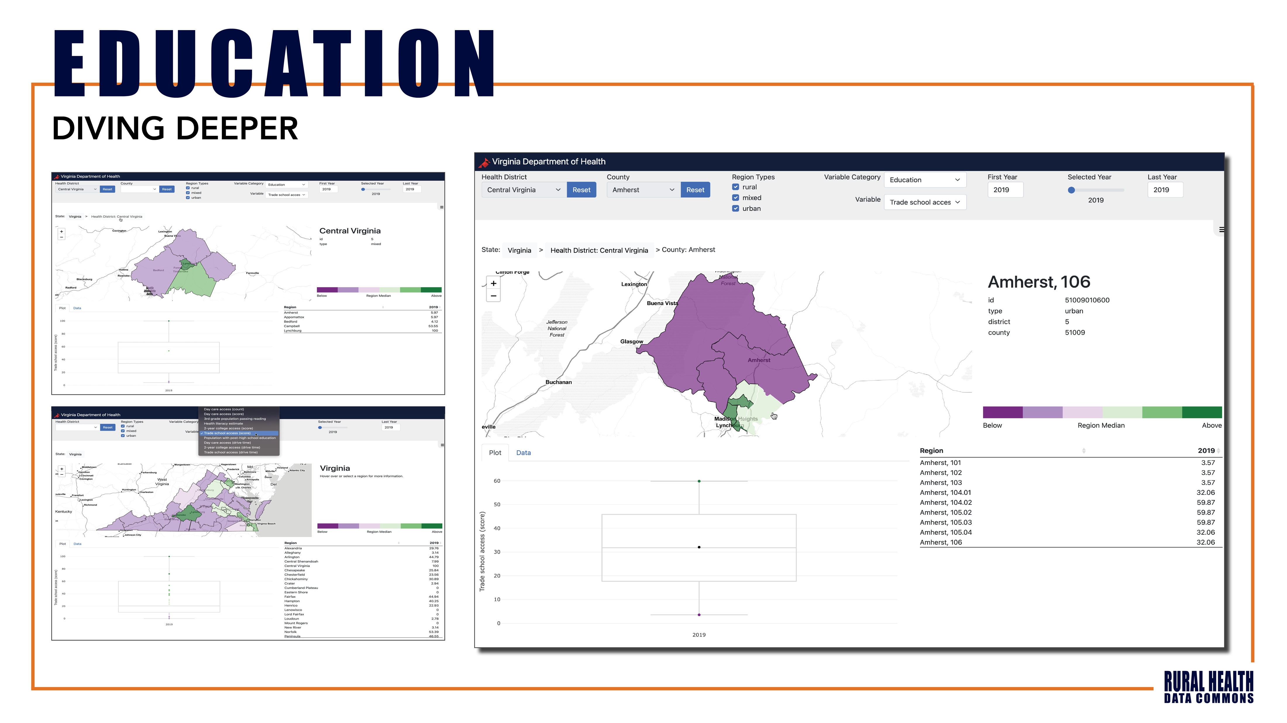

Slide 32
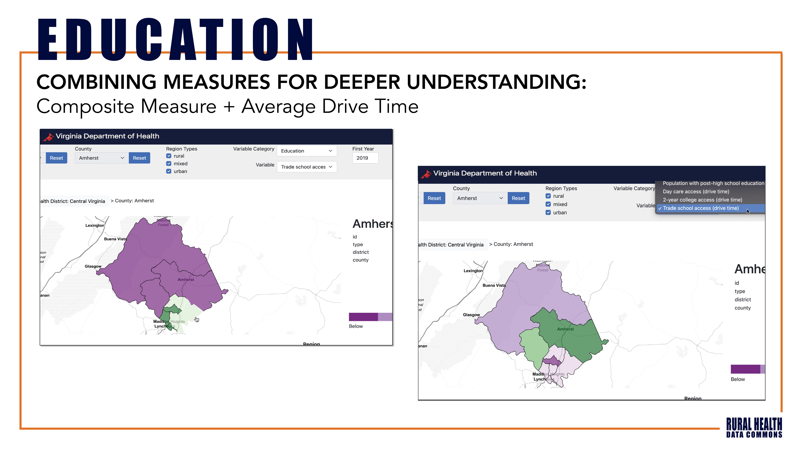

Slide 33


Slide 34
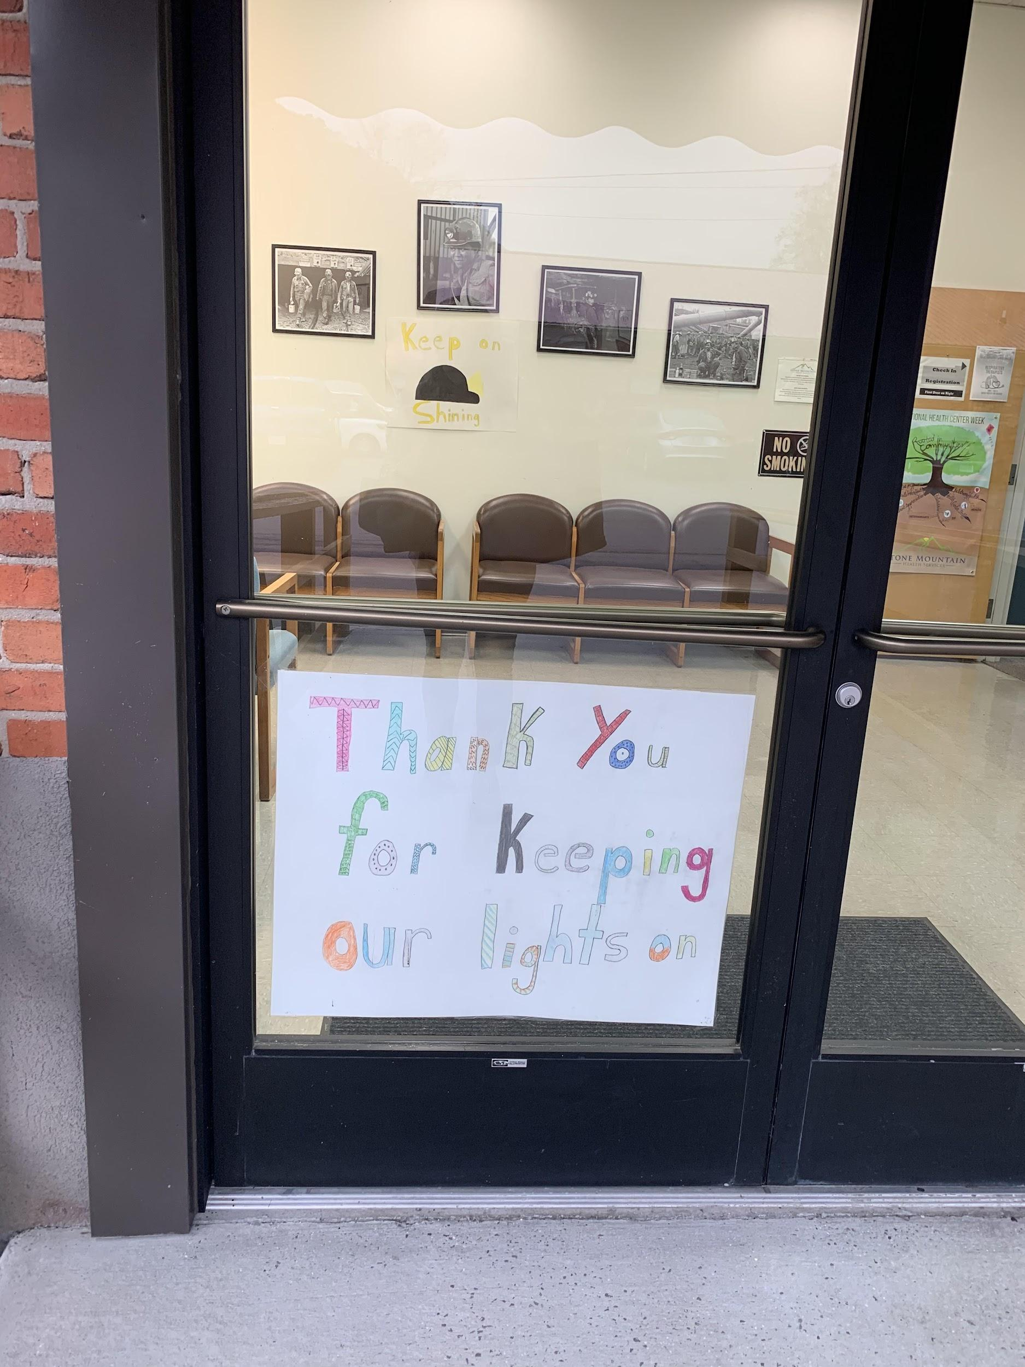
VA-SORH Contact Information
Heather Anderson, MPH
Division Director, Primary Care & Rural Health
Heather.Anderson@vdh.virginia.gov
Sarah O’Connor, MPH
VA-SORH Program Coordinator
Sarah.Oconnor@vdh.virginia.gov
Clarissa Noble, MPH
Rural Health Manager
Clarissa.Noble@vdh.virginia.gov
Ellie Wilson
VA-SORH Outreach Coordinator
Ellie.Wilson@vdh.virginia.gov
Stone Mountain Health Services Black Lung Clinic, St. Charles, VA

Slide 35


